Slide 1
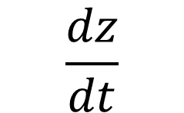
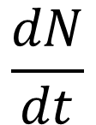
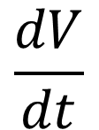
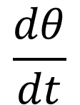
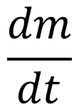

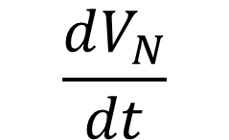

Projectile Characteristics
Density (ρ)
Diameter ($L$)
Velocity ($V$)
Angle (θ)
M
Iron
1 m
1 km/s
90 ̊
P
Stony-Iron
45 ̊
S
Stony
10 km
40 km/s
15 ̊
C
Chondritic
Atmospheric Effects
Atmospheric Conditions
$$\frac{dz}{dt}$$
Disintegration
Top of Atmosphere
Gravity
$$\frac{dV_{N}}{dt}$$
Dispersion
z_{b}
g _{T}
Altitude
Atmospheric
Profiles
$$\frac{dN}{dt}$$
Fragmentation
V _{Ni}
Airburst
Surface
z
Pressure
N_{i}
z*
V _{Nf}
D_{SC}
P(z)
Temperature
Ablation
N_{f}
Simple-to-Complex
Crater Diameter
T(z)
$$\frac{dm}{dt}$$
m _{i}
P₀
ρ_{a} (z)
Density
m_{f}
Simple
T₀
$$\frac{dθ}{dt}$$
Angle
Impact
Characteristics
Target
Characteristics
ρ₀
θ_{i}
Scale
Height
θ_{f}
Complex
H_{T}
$$\frac{dV}{dt}$$
Velocity
Crater
Formation
R_{T}
Surface
Density
ρ_{T}
V_{i}
V_{f}
Target
Radius
* Not to Scale
Notes:
AEM diagram. A representation of all factors taken into account within AEM, including (A) characteristics of each projectile in the population, (B) atmospheric effects and impact characteristics, and (C) atmospheric conditions and target characteristics. See Section~\ref{sec:methodover} for reference.​

Slide 2
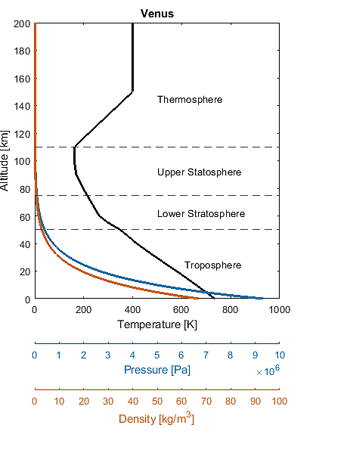
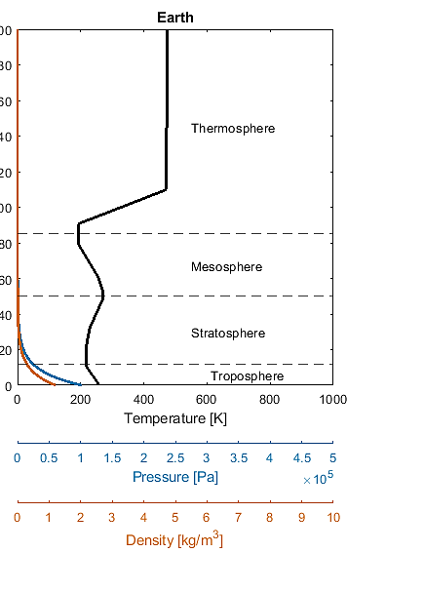
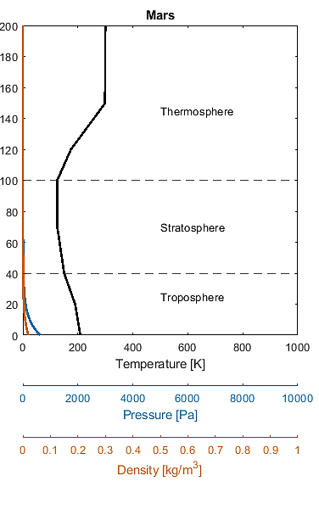
Venus
Earth
Mars
Altitude (km)
Notes:
%% Theoretical Venusian Crater Size-Frequency Distribution
% Atmospheric effects code
% Developed by: Marissa Dudek (1), R Shane McGary (2)
% (1) University of North Carolina at Chapel Hill, Geological Sciences
% (2) James Madison University, Geology and Environmental Sciences
% Clean workspace
clc; format long;
counter = 0;
% ----------------------------------------------------------------------------
% Import previously created workspace
% ... Read as 'SectionsOfCodeRun_Date_Target_NumberProjectiles'
load('CSFD_211005_ProjectilePop_unique\All_Variables.mat')
% Establish zeros matricies
proj_alt = (1:1:200000).';
proj_ztemp = zeros(200000,1);
proj_zrho = zeros(200000,1);
proj_zpress = zeros(200000,1);
flag.zrho(1) = 2;
% ----------------------------------------------------------------------------
% Venus
for j = 1:200000
% ---------------------------
% Blumenthal, Kay, Palen, Smith (2012). Understanding Our Universe. New York: W.W. Norton & Company. p. 167. ISBN 9780393912104.
% ... temperature (C)
if proj_alt(j) >= 150000
proj_ztemp(j) = 127;
elseif proj_alt(j) >= 110000
proj_ztemp(j) = ((proj_alt(j)-150000)/((150000-110000)/((127)-(-112))))+(127);
elseif proj_alt(j) >= 100000
proj_ztemp(j) = -112;
elseif proj_alt(j) >= 90000
proj_ztemp(j) = ((proj_alt(j)-100000)/((100000-90000)/((-112)-(-104))))+(-112);
elseif proj_alt(j) >= 80000
proj_ztemp(j) = ((proj_alt(j)-90000)/((90000-80000)/((-104)-(-76))))+(-104);
elseif proj_alt(j) >= 70000
proj_ztemp(j) = ((proj_alt(j)-80000)/((80000-70000)/((-76)-(-43))))+(-76);
elseif proj_alt(j) >= 60000
proj_ztemp(j) = ((proj_alt(j)-70000)/((70000-60000)/((-43)-(-10))))+(-43);
elseif proj_alt(j) >= 55000
proj_ztemp(j) = ((proj_alt(j)-60000)/((60000-55000)/((-10)-(27))))+(-10);
elseif proj_alt(j) >= 50000
proj_ztemp(j) = ((proj_alt(j)-55000)/((55000-50000)/((27)-(75))))+(27);
elseif proj_alt(j) >= 45000
proj_ztemp(j) = ((proj_alt(j)-50000)/((50000-45000)/((75)-(110))))+(75);
elseif proj_alt(j) >= 40000
proj_ztemp(j) = ((proj_alt(j)-45000)/((45000-40000)/((110)-(143))))+(110);
elseif proj_alt(j) >= 30000
proj_ztemp(j) = ((proj_alt(j)-40000)/((40000-30000)/((143)-(222))))+(143);
elseif proj_alt(j) >= 20000
proj_ztemp(j) = ((proj_alt(j)-30000)/((30000-20000)/((222)-(306))))+(222);
elseif proj_alt(j) >= 10000
proj_ztemp(j) = ((proj_alt(j)-20000)/((20000-10000)/((306)-(385))))+(306);
elseif proj_alt(j) >= 0
proj_ztemp(j) = ((proj_alt(j)-10000)/((10000-0)/(385-(462))))+(385);
end
% ---------------------------
% ... convert temperature from celcius to kelvin (K)
proj_ztemp(j) = (proj_ztemp(j) + 273.15);
% ---------------------------
% ... density (kg/m3)
if flag.zrho(1) == 1
proj_zrho(j) = 67 * (exp(-proj_alt(j)/H.target));
else
% Herrick and Phillips (pg. 260-261)
if proj_alt(j) >= 70000
proj_zrho(j) = 0.0789 * (exp(-23.3*((proj_alt(j)-70000)/100000)));
%proj_zrho(j) = 67 * (exp(-proj_alt(j)/H.target));
elseif proj_alt(j) < 70000
proj_zrho(j) = 67 * ((1-(proj_alt(j)/94800))^5);
end
end
% ---------------------------
% ... pressure (Pa)
proj_zpress(j) = (93.22*(10^5)) * (exp((-g.Venus*0.04334*proj_alt(j))/(8.314*737)));
% ---------------------------
end
Vztemp = proj_ztemp;
Vzrho = proj_zrho;
Vzpress = proj_zpress;
% Earth
for j = 1:200000
% ---------------------------
% ... temperature (C)
if proj_alt(j) >= 110000
proj_ztemp(j) = 200;
elseif proj_alt(j) >= 90500
proj_ztemp(j) = ((proj_alt(j)-110000)/((110000-90500)/(200-(-83))))+(200);
elseif proj_alt(j) >= 80000
proj_ztemp(j) = -83;
elseif proj_alt(j) >= 60500
proj_ztemp(j) = ((proj_alt(j)-80000)/((80000-60500)/((-83)-(-17))))+(-83);
elseif proj_alt(j) >= 52500
proj_ztemp(j) = ((proj_alt(j)-60500)/((60500-52500)/((-17)-(-3))))+(-17);
elseif proj_alt(j) >= 48500
proj_ztemp(j) = -3;
elseif proj_alt(j) >= 32000
proj_ztemp(j) = ((proj_alt(j)-48500)/((48500-32000)/((-3)-(-45))))+(-3);
elseif proj_alt(j) >= 20000
proj_ztemp(j) = ((proj_alt(j)-32000)/((32000-20000)/((-45)-(-57))))+(-45);
elseif proj_alt(j) >= 11000
proj_ztemp(j) = -57;
elseif proj_alt(j) >= 0
proj_ztemp(j) = ((proj_alt(j)-11000)/((11000-0)/(14+(-57))))+(-57);
end
% ---------------------------
% ... convert temperature from celcius to kelvin
proj_ztemp(j) = (proj_ztemp(j) + 273.15);
% ---------------------------
% ... density (kg/m3)
proj_zrho(j) = (1.20) * (exp(-proj_alt(j)/H.Earth));
% ---------------------------
% ... pressure (Pa)
proj_zpress(j) = (10.13*(10^4)) * (exp((-g.Earth*0.02896*proj_alt(j))/(8.314*288)));
% ---------------------------
end
Eztemp = proj_ztemp;
Ezrho = proj_zrho;
Ezpress = proj_zpress;
% Mars
for j = 1:200000
% ---------------------------
% ... temperature (K)
if proj_alt(j) >= 150000
proj_ztemp(j) = 300;
elseif proj_alt(j) >= 120000
proj_ztemp(j) = ((proj_alt(j)-150000)/((150000-120000)/(300-(175))))+(300);
elseif proj_alt(j) >= 100000
proj_ztemp(j) = ((proj_alt(j)-120000)/((120000-100000)/(175-(125))))+(175);
elseif proj_alt(j) >= 70000
proj_ztemp(j) = ((proj_alt(j)-90000)/((90000-70000)/(125-(125))))+(125);
elseif proj_alt(j) >= 40000
proj_ztemp(j) = ((proj_alt(j)-70000)/((70000-40000)/(125-(150))))+(125);
elseif proj_alt(j) >= 30000
proj_ztemp(j) = ((proj_alt(j)-40000)/((40000-30000)/(150-(170))))+(150);
elseif proj_alt(j) >= 20000
proj_ztemp(j) = ((proj_alt(j)-30000)/((30000-20000)/(170-(190))))+(170);
elseif proj_alt(j) >= 0
proj_ztemp(j) = ((proj_alt(j)-20000)/((20000-0)/(190-(209))))+(190);
end
% ---------------------------
% ... density (kg/m3)
proj_zrho(j) = (0.02) * (exp(-proj_alt(j)/H.Mars));
% ---------------------------
% ... pressure (Pa)
proj_zpress(j) = (636) * (exp((-g.Mars*0.04334*proj_alt(j))/(8.314*210)));
% ---------------------------
end
Mztemp = proj_ztemp;
Mzrho = proj_zrho;
Mzpress = proj_zpress;
% ----------------------------------------------------------------------------
%% Plot
% subplot(1,3,1)
% plot(Vztemp,proj_alt/1000,'Color',[0.8500 0.3250 0.0980],'LineWidth',2); hold on;
% plot(Eztemp,proj_alt/1000,'Color',[0 0.4470 0.7410],'LineWidth',2); hold on;
% plot(Mztemp,proj_alt/1000,'Color',[0.6350 0.0780 0.1840],'LineWidth',2); hold on;
% xlabel('Temperature (K)'); ylabel('Altitude (km)')
% legend({'Venus','Earth','Mars'},'Location','northeast');
%
% subplot(1,3,2)
% semilogx(Vzpress,proj_alt/1000,'Color',[0.8500 0.3250 0.0980],'LineWidth',2); hold on;
% semilogx(Ezpress,proj_alt/1000,'Color',[0 0.4470 0.7410],'LineWidth',2); hold on;
% semilogx(Mzpress,proj_alt/1000,'Color',[0.6350 0.0780 0.1840],'LineWidth',2); hold on;
% xlabel('Pressure (Pa)'); ylabel('Altitude (km)')
%
% subplot(1,3,3)
% semilogx(Vzrho,proj_alt/1000,'Color',[0.8500 0.3250 0.0980],'LineWidth',2); hold on;
% semilogx(Ezrho,proj_alt/1000,'Color',[0 0.4470 0.7410],'LineWidth',2); hold on;
% semilogx(Mzrho,proj_alt/1000,'Color',[0.6350 0.0780 0.1840],'LineWidth',2); hold on;
% xlabel('Density (kg/m^3)'); ylabel('Altitude (km)')
set(0,'DefaultFigureWindowStyle','docked')
% Venus
msx = Vztemp; msy = proj_alt/1000;
lx = (1000/1e7)*(Vzpress); ly = proj_alt/1000;
evx = (1000/100)*Vzrho; evy = proj_alt/1000;
figure(1)
a = axes('units','normalized','position',[.1 .35 .7 .6],'xtick',0:100:1000);
plot(msx,msy,'color','k','LineWidth',2); hold on; xlim([0 1000]);
plot(lx,ly,'color','#0072b2','LineWidth',2); hold on
plot(evx,evy,'color','#d55e00','LineWidth',2);
title('Venus'); ylabel('Altitude [km]');
yline(50,'--'); yline(75,'--'); yline(110,'--');
text(610,25,'Troposphere'); text(500,62.5,'Lower Stratosphere'); text(500,92.5,'Upper Statosphere'); text(500,145,'Thermosphere');
xlabel(a,'Temperature [K]'); hold on;
b = axes('units','normalized','position',[.1 .25 .7 0.000001],'xlim',[0 1e7],'color','#0072b2','xtick',0:1000000:1e7,'XColor','#0072b2');
xlabel(b,'Pressure [Pa]'); b.FontSize = 10;
c = axes('units','normalized','position',[.1 .15 .7 0.000001],'xlim',[0 100],'color','#d55e00','xtick',0:10:100,'XColor','#d55e00');
xlabel(c,'Density [kg/m^3]'); c.FontSize = 10;
% Earth
msx = Eztemp; msy = proj_alt/1000;
lx = (1000/5e5)*(Ezpress); ly = proj_alt/1000;
evx = (1000/10)*Ezrho; evy = proj_alt/1000;
figure(2)
a = axes('units','normalized','position',[.1 .35 .7 .6],'xtick',0:50:1000);
plot(msx,msy,'color','k','LineWidth',2); hold on; xlim([0 1000]);
plot(lx,ly,'color','#0072b2','LineWidth',2); hold on
plot(evx,evy,'color','#d55e00','LineWidth',2);
title('Earth'); ylabel('Altitude [km]');
yline(12,'--'); yline(50,'--'); yline(85,'--');
text(610,6,'Troposphere'); text(550,30,'Stratosphere'); text(550,67.5,'Mesosphere'); text(550,145,'Thermosphere');
xlabel(a,'Temperature [K]'); hold on;
b = axes('units','normalized','position',[.1 .25 .7 0.000001],'xlim',[0 5e5],'color','#0072b2','xtick',0:50000:5e5,'XColor','#0072b2');
xlabel(b,'Pressure [Pa]'); b.FontSize = 10;
c = axes('units','normalized','position',[.1 .15 .7 0.000001],'xlim',[0 10],'color','#d55e00','xtick',0:1:10,'XColor','#d55e00');
xlabel(c,'Density [kg/m^3]'); c.FontSize = 10;
% Mars
msx = Mztemp; msy = proj_alt/1000;
lx = (1000/10000)*(Mzpress); ly = proj_alt/1000;
evx = (1000/1)*Mzrho; evy = proj_alt/1000;
figure(3)
a = axes('units','normalized','position',[.1 .35 .7 .6],'xtick',0:50:1000);
plot(msx,msy,'color','k','LineWidth',2); hold on; xlim([0 1000]);
plot(lx,ly,'color','#0072b2','LineWidth',2); hold on
plot(evx,evy,'color','#d55e00','LineWidth',2);
title('Mars'); ylabel('Altitude [km]');
yline(40,'--'); yline(100,'--');
text(500,25,'Troposphere'); text(500,70,'Stratosphere'); text(500,145,'Thermosphere');
xlabel(a,'Temperature [K]'); hold on;
b = axes('units','normalized','position',[.1 .25 .7 0.000001],'xlim',[0 10000],'color','#0072b2','xtick',0:2000:10000,'XColor','#0072b2');
xlabel(b,'Pressure [Pa]'); b.FontSize = 10;
c = axes('units','normalized','position',[.1 .15 .7 0.000001],'xlim',[0 1],'color','#d55e00','xtick',0:0.1:1,'XColor','#d55e00');
xlabel(c,'Density [kg/m^3]'); c.FontSize = 10;
% Venus
figure(4)
semilogx(Vzrho,proj_alt/1000); hold on;
xlabel('Density (kg/m^3)'); ylabel('Altitude (km)'); legend('Isothermal','Isentropic'); title('Venusian Atmospheric Density Profile'); grid on;
% --------------------------------------------------
% figure(4)
% % Venus
% subplot(1,3,1)
% semilogx(Vztemp,proj_alt/1000,'color','k','LineWidth',2); hold on;
% semilogx(Vzrho,proj_alt/1000,'color','#0072b2','LineWidth',2); hold on;
% semilogx(Vzpress,proj_alt/1000,'color','#d55e00','LineWidth',2); hold on;
% xline(0.1,'color',[0.5, 0.5, 0.5],'LineWidth',1.5);
% yline(50,'--'); yline(75,'--'); yline(110,'--');
% text(10e-14,25,'Troposphere'); text(10e-14,62.5,'Lower Stratosphere'); text(10e-14,92.5,'Upper Statosphere'); text(10e-14,145,'Thermosphere');
% title({'Venus'}); ylabel('Altitude [km]'); axis([10e-15 10e8 0 200]);
% legend({'Temperature (K)','Density (kg/m3)','Pressure (Pa)'},'Location','southoutside'); grid on; grid minor;
% % Earth
% subplot(1,3,2)
% semilogx(Eztemp,proj_alt/1000,'color','k','LineWidth',2); hold on;
% semilogx(Ezrho,proj_alt/1000,'color','#0072b2','LineWidth',2); hold on;
% semilogx(Ezpress,proj_alt/1000,'color','#d55e00','LineWidth',2); hold on;
% xline(0.1,'color',[0.5, 0.5, 0.5],'LineWidth',1.5);
% yline(12,'--'); yline(50,'--'); yline(85,'--');
% text(10e-14,6,'Troposphere'); text(10e-14,25,'Stratosphere'); text(10e-14,67.5,'Mesosphere'); text(10e-14,145,'Thermosphere');
% title({'Earth'}); ylabel('Altitude [km]'); axis([10e-15 10e8 0 200]); grid on; grid minor;
% legend({'Temperature (K)','Density (kg/m3)','Pressure (Pa)'},'Location','southoutside');
% % Mars
% subplot(1,3,3)
% semilogx(Mztemp,proj_alt/1000,'color','k','LineWidth',2); hold on;
% semilogx(Mzrho,proj_alt/1000,'color','#0072b2','LineWidth',2); hold on;
% semilogx(Mzpress,proj_alt/1000,'color','#d55e00','LineWidth',2); hold on;
% xline(0.1,'color',[0.5, 0.5, 0.5],'LineWidth',1.5);
% yline(40,'--'); yline(100,'--');
% text(10e-14,25,'Troposphere'); text(10e-14,70,'Stratosphere'); text(10e-14,145,'Thermosphere');
% title({'Mars'}); ylabel('Altitude [km]'); axis([10e-15 10e8 0 200]); grid on; grid minor;
% legend({'Temperature (K)','Density (kg/m3)','Pressure (Pa)'},'Location','southoutside');

Slide 3
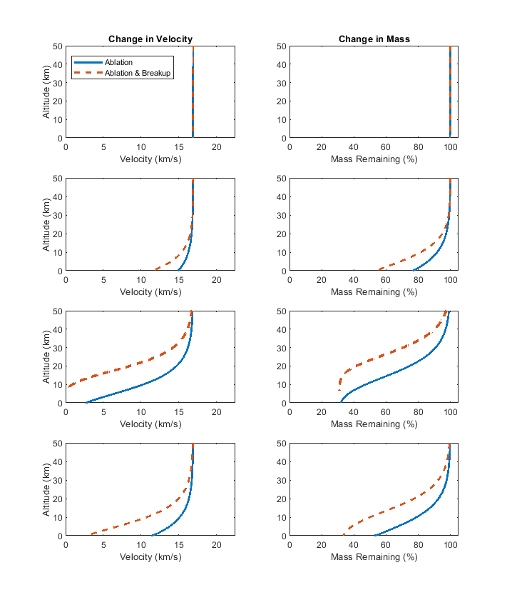
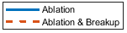
Velocity and Mass Evolutions of Terrestrial Analogs
Change in Velocity
Chicxulub Crater
Change in Mass
AEM Impact
Characteristics
V = 16.8 km/s
M = 99.7 %
Θ = ~ 45 °
D_{f} = 13.9 km
Meteor Crater
V = 11 – 15 km/s
M = 51 – 77 %
Θ = ~ 45 °
D_{f} = 40 – 46 m
Chelyabinsk Meteor
V = 0 – 3 km/s
M = 0 – 32 %
Θ = ~ 20 °
D_{f} = 0 – 14 m
Tunguska Air Burst
V = 2 – 12 km/s
M = 33 – 53 %
Θ = ~ 45 °
D_{f} = 34 – 41 m
Notes:
flag.vel(1) = 1971;
flag.shape(1) = 1.21;
flag.drag(1) = 0.47;
flag.ang(1) = 1971;
flag.lift(1) = 0.001;
flag.mass(1) = 1971;
flag.htc(1) = 0.02;
flag.hoa(1) = 5e6;
flag.zrho(1) = 1;
FLAVRS = load('ProjPop_TerrestrialAnalog_v4_FLAVRSM.mat'); % Terrestrial Analog Pop (correct densities)
FLAVRS = FLAVRS.FLAVRS;
% figure(11)
% k = 1;
% subplot(4,2,1)
% plot(Evel(k,:).'/1000,Ealt(k,:).'/1000,'-','LineWidth',2); hold on;
% xlim([0 22.5]); ylim([0 50]); xlabel('Velocity (km/s)'); ylabel('Altitude (km)');
% legend('Ablation','Ablation & Breakup','location','northwest')
% title('Change in Velocity');
% subplot(4,2,2)
% plot(Emassr(k,:).',Ealt(k,:).'/1000.','-','LineWidth',2); hold on;
% xlim([0 105]); ylim([0 50]); xlabel('Mass Remaining (%)');
% title('Change in Mass');
% k = 2;
% subplot(4,2,3)
% plot(Evel(k,:).'/1000,Ealt(k,:).'/1000,'-','LineWidth',2); hold on;
% xlim([0 22.5]); ylim([0 50]); xlabel('Velocity (km/s)'); ylabel('Altitude (km)');
% subplot(4,2,4)
% plot(Emassr(k,:).',Ealt(k,:).'/1000.','-','LineWidth',2); hold on;
% xlim([0 105]); ylim([0 50]); xlabel('Mass Remaining (%)');
% k = 3;
% subplot(4,2,5)
% plot(Evel(k,:).'/1000,Ealt(k,:).'/1000,'-','LineWidth',2); hold on;
% xlim([0 22.5]); ylim([0 50]); xlabel('Velocity (km/s)'); ylabel('Altitude (km)');
% subplot(4,2,6)
% plot(Emassr(k,:).',Ealt(k,:).'/1000.','-','LineWidth',2); hold on;
% xlim([0 105]); ylim([0 50]); xlabel('Mass Remaining (%)');
% k = 4;
% subplot(4,2,7)
% plot(Evel(k,:).'/1000,Ealt(k,:).'/1000,'-','LineWidth',2); hold on;
% xlim([0 22.5]); ylim([0 50]); xlabel('Velocity (km/s)'); ylabel('Altitude (km)');
% subplot(4,2,8)
% plot(Emassr(k,:).',Ealt(k,:).'/1000.','-','LineWidth',2); hold on;
% xlim([0 105]); ylim([0 50]); xlabel('Mass Remaining (%)');

Slide 4
Dispersion of Terrestrial Analog Projectiles
Airburst Limit
Chicxulub
Chyba et al.
(1993)
Meteor
This Study
Chelyabinsk
Tunguska
Collins et al.
(2005)
Altitude (km)
Pancake Factor (L_{Z}/L₀)
Notes:
flag.vel(1) = 1971;
flag.shape(1) = 1.21;
flag.drag(1) = 0.47;
flag.ang(1) = 1971;
flag.lift(1) = 0.001;
flag.mass(1) = 1971;
flag.htc(1) = 0.02;
flag.hoa(1) = 5e6;
flag.zrho(1) = 1;
FLAVRS = load('ProjPop_TerrestrialAnalog_v4_FLAVRSM.mat'); % Terrestrial Analog Pop (correct densities)
FLAVRS = FLAVRS.FLAVRS;
plot(Epanfact.',Ealt.'/1000,'LineWidth',2); hold on; xlabel('Pancake Factor (Lz/L0)'); xlim([0 25]); ylim([0 200]); ylim([0 100]);

Slide 5

Theoretical Projectile Evolution with Ablation Only
Change in Velocity
Mars
Mass Remaining
Diameter
10 m
100 m
1 km
10 km
Density
Chondritic (2.7 g/cm³)
10 m
Stony (3.3 g/cm³)
10 m
Stony-Iron (4.5 g/cm³)
Iron (7.8 g/cm³)
Earth
30 km/s
20 km/s
10 km/s
10 m
1 km
Venus
30 km/s
20 km/s
10 km/s
10 m
100 m
1 km
10 km
Notes:
flag.vel(1) = 1971;
flag.shape(1) = 1.21;
flag.drag(1) = 0.47;
flag.ang(1) = 1971;
flag.lift(1) = 0.001;
flag.mass(1) = 1971;
flag.htc(1) = 0.02;
flag.hoa(1) = 5e6;
flag.zrho(1) = 1;
FLAVRS = load('ProjPop_10m-10km_allrho_10-40kms_45.mat'); % Array 2, ablation (population 1)
FLAVRS = FLAVRS.FLAVRS;
FLAVRS(:,3) = FLAVRS(:,11); % correct for FLAVRSM angle change up
figure(12)
for k = 1:n.projectiles
subplot(3,2,1);plot(Mvel(k,:)/1000,Malt(k,:)/1000,'Color',color_rhop(k,:),'LineWidth',width_Lp(k,:)); hold on; ylabel('Altitude (km)'); xlabel('Velocity (km/s)'); xlim([0 40]); ylim([0 150]);
subplot(3,2,2);plot(Mmassr(k,:),Malt(k,:)/1000,'Color',color_rhop(k,:),'LineWidth',width_Lp(k,:)); hold on; xlabel('Mass Remaining (%)'); xlim([0 100]); ylim([0 200]);
subplot(3,2,3);plot(Evel(k,:)/1000,Ealt(k,:)/1000,'Color',color_rhop(k,:),'LineWidth',width_Lp(k,:)); hold on; ylabel('Altitude (km)'); xlabel('Velocity (km/s)'); xlim([0 40]); ylim([0 150]);
subplot(3,2,4);plot(Emassr(k,:),Ealt(k,:)/1000,'Color',color_rhop(k,:),'LineWidth',width_Lp(k,:)); hold on; xlabel('Mass Remaining (%)'); xlim([0 100]); ylim([0 200]);
subplot(3,2,5);plot(Vvel(k,:)/1000,Valt(k,:)/1000,'Color',color_rhop(k,:),'LineWidth',width_Lp(k,:)); hold on; ylabel('Altitude (km)'); xlabel('Velocity (km/s)'); xlim([0 40]); ylim([0 150]);
subplot(3,2,6);plot(Vmassr(k,:),Valt(k,:)/1000,'Color',color_rhop(k,:),'LineWidth',width_Lp(k,:)); hold on; xlabel('Mass Remaining (%)'); xlim([0 100]); ylim([0 200]);
end

Slide 6
Theoretical Projectile Evolution with Ablation & Fragmentation
Change in Velocity
Mars
Mass Remaining
Diameter
10 m
100 m
1 km
10 km
Density
Chondritic (2.7 g/cm³)
10 m
Stony (3.3 g/cm³)
10 m
Stony-Iron (4.5 g/cm³)
Iron (7.8 g/cm³)
Earth
30 km/s
20 km/s
10 km/s
10 m
100 m
1 km
Venus
10 m
30 km/s
20 km/s
10 km/s
100 m
1 km
10 km
Notes:
flag.vel(1) = 1971;
flag.shape(1) = 1.21;
flag.drag(1) = 0.47;
flag.ang(1) = 1971;
flag.lift(1) = 0.001;
flag.mass(1) = 1971;
flag.htc(1) = 0.02;
flag.hoa(1) = 5e6;
flag.zrho(1) = 1;
FLAVRS = load('ProjPop_10m-10km_allrho_10-40kms_45.mat'); % Array 2, ablation (population 1)
FLAVRS = FLAVRS.FLAVRS;
FLAVRS(:,3) = FLAVRS(:,11); % correct for FLAVRSM angle change up
figure(12)
for k = 1:n.projectiles
subplot(3,2,1);plot(Mvel(k,:)/1000,Malt(k,:)/1000,'Color',color_rhop(k,:),'LineWidth',width_Lp(k,:)); hold on; ylabel('Altitude (km)'); xlabel('Velocity (km/s)'); xlim([0 40]); ylim([0 150]);
subplot(3,2,2);plot(Mmassr(k,:),Malt(k,:)/1000,'Color',color_rhop(k,:),'LineWidth',width_Lp(k,:)); hold on; xlabel('Mass Remaining (%)'); xlim([0 100]); ylim([0 200]);
subplot(3,2,3);plot(Evel(k,:)/1000,Ealt(k,:)/1000,'Color',color_rhop(k,:),'LineWidth',width_Lp(k,:)); hold on; ylabel('Altitude (km)'); xlabel('Velocity (km/s)'); xlim([0 40]); ylim([0 150]);
subplot(3,2,4);plot(Emassr(k,:),Ealt(k,:)/1000,'Color',color_rhop(k,:),'LineWidth',width_Lp(k,:)); hold on; xlabel('Mass Remaining (%)'); xlim([0 100]); ylim([0 200]);
subplot(3,2,5);plot(Vvel(k,:)/1000,Valt(k,:)/1000,'Color',color_rhop(k,:),'LineWidth',width_Lp(k,:)); hold on; ylabel('Altitude (km)'); xlabel('Velocity (km/s)'); xlim([0 40]); ylim([0 150]);
subplot(3,2,6);plot(Vmassr(k,:),Valt(k,:)/1000,'Color',color_rhop(k,:),'LineWidth',width_Lp(k,:)); hold on; xlabel('Mass Remaining (%)'); xlim([0 100]); ylim([0 200]);
end

Slide 7
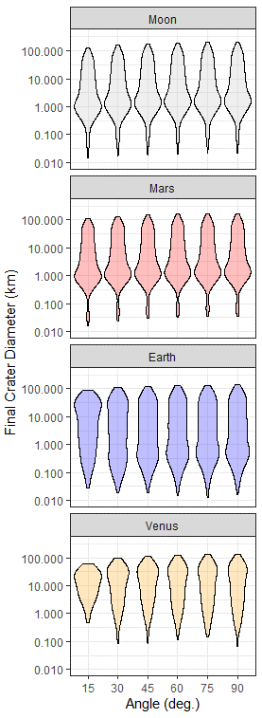
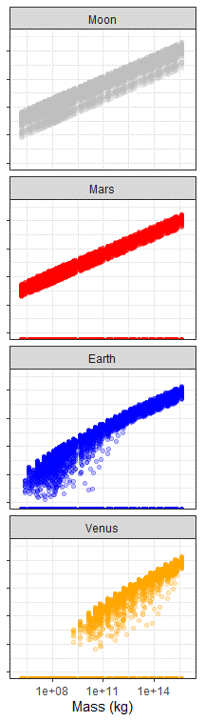
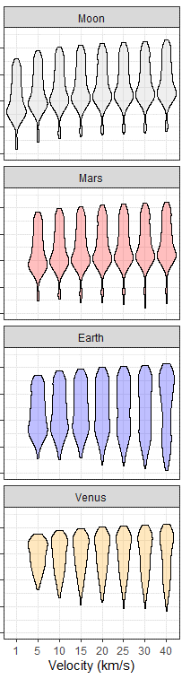
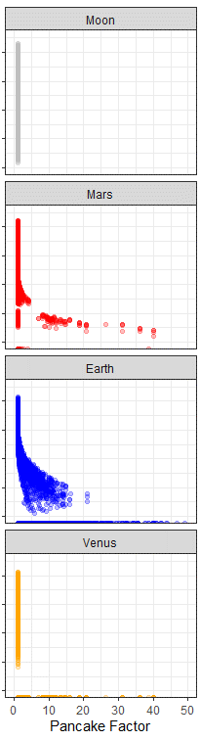
Projectile Characteristic vs. Final Crater Diameter
Pancake Limit = 5
Pancake Gap
100 m
Final Crater Diameter (km)
1 km
10 km
Initial Angle
(deg.)
Initial Mass
(kg)
Initial Velocity
(km/s)
Pancake Factor
(at impact)

Slide 8
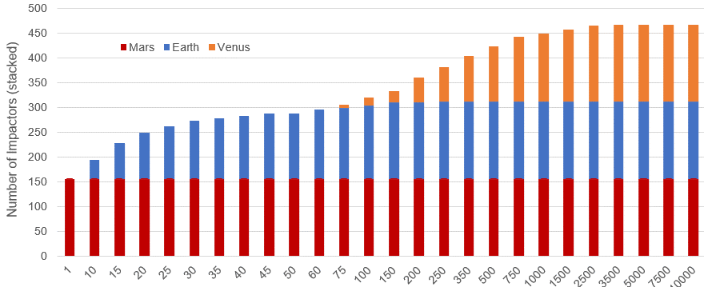
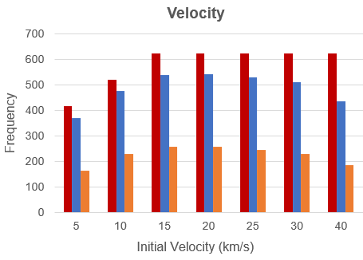
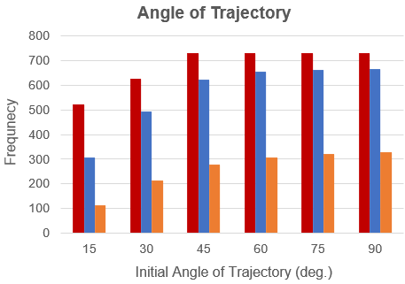
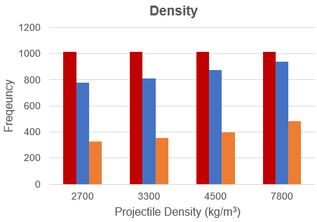
Initial Characteristics of Theoretical Impactors
A. Diameter
Mars
Earth
Venus
Venus
Number of Impactors (Stacked)
Earth
Mars
Initial Diameter (m)
B. Velocity
C. Angle of Trajectory
D. Density
Frequency
Frequency
Frequency
Initial Velocity (km/s)
Initial Angle (deg.)
Projectile Density (kg/m³)

Slide 9
Model Sensitivity to Atmospheric Effect Equations
Change in Velocity
Change in Mass
Change in Angle
A. Change in Velocity
2004
2003
2005
2005
2003
B. Change in Angle
C. Change in Mass
1983
1983
1958
1958
1993
1971

Slide 10
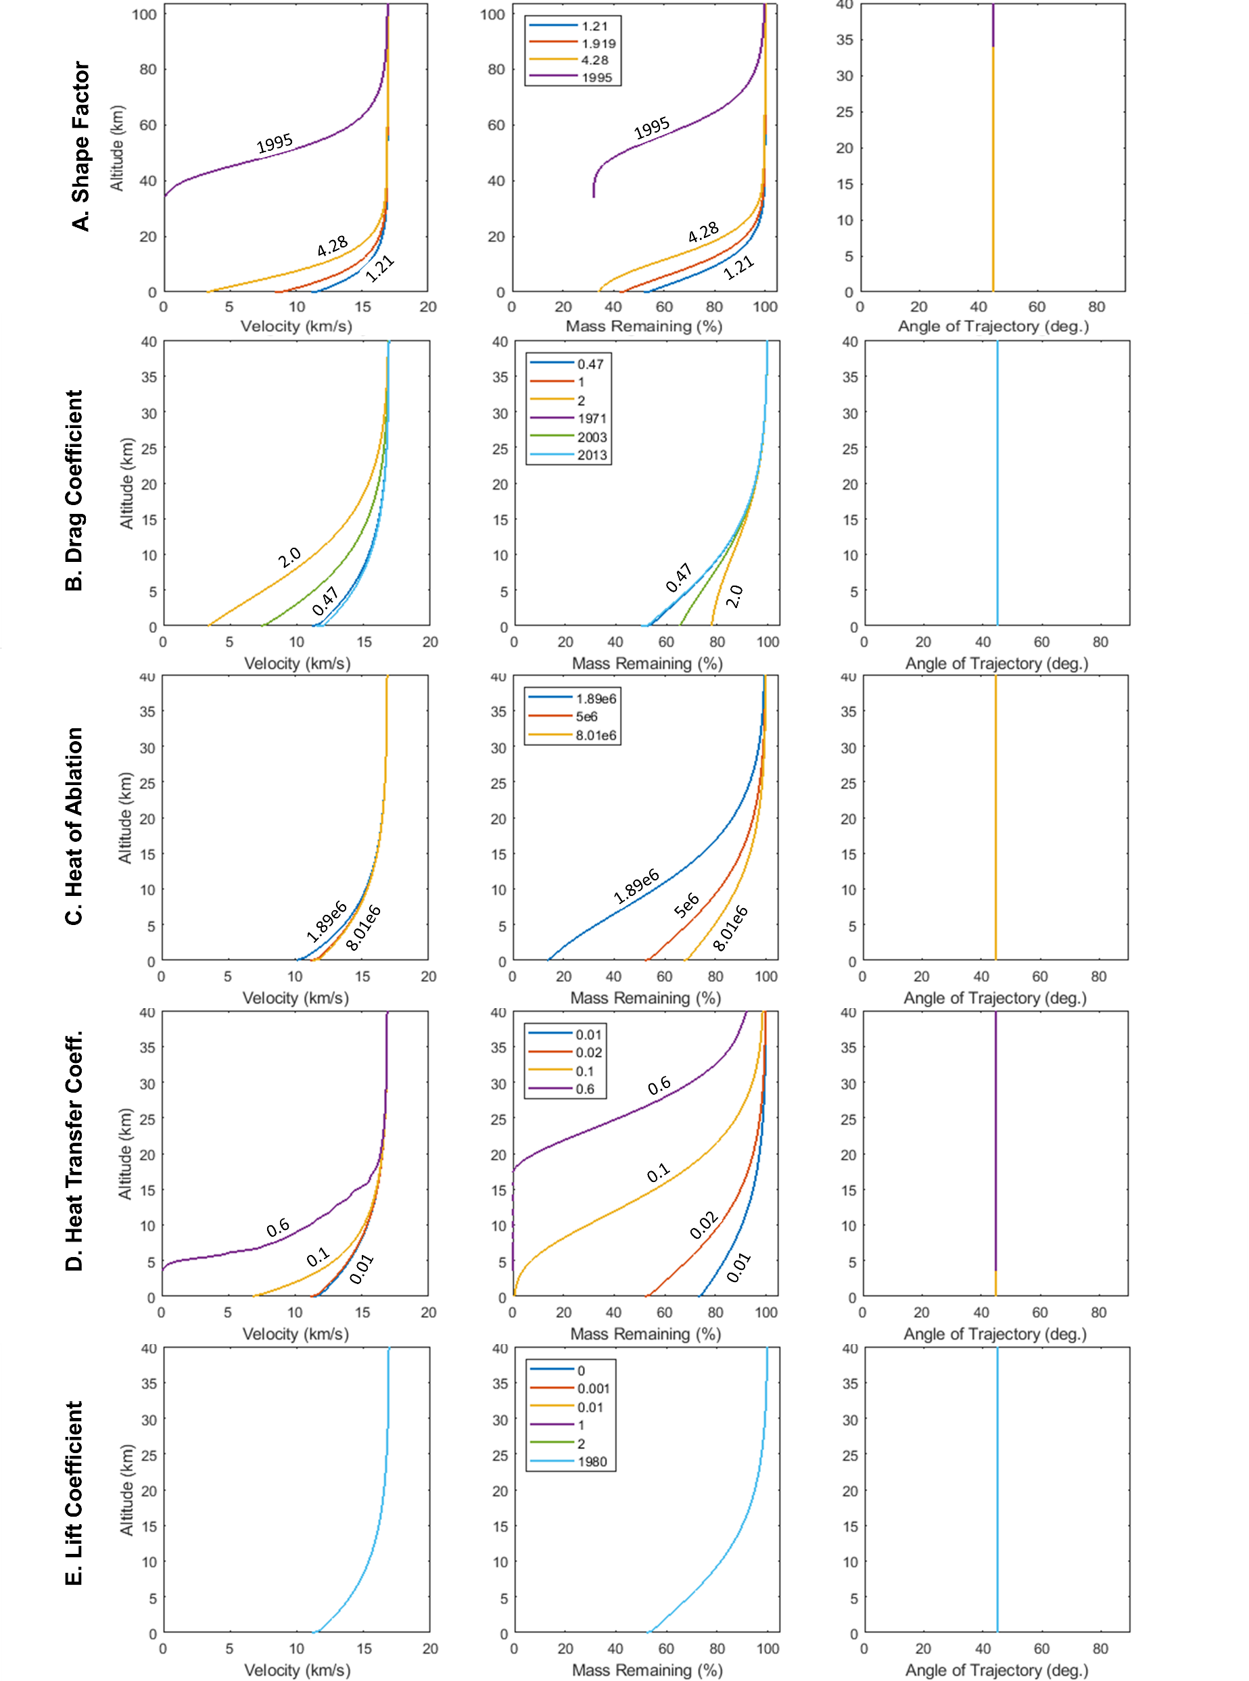
Model Sensitivity to Atmospheric Effect Parameters
Change in Velocity
Change in Mass
Change in Angle
A. Shape Factor
B. Drag Coefficient
C. Heat of Ablation
D. Heat Transfer Coeff.
E. Lift Coefficient
E. Lift Coefficient

Slide 12
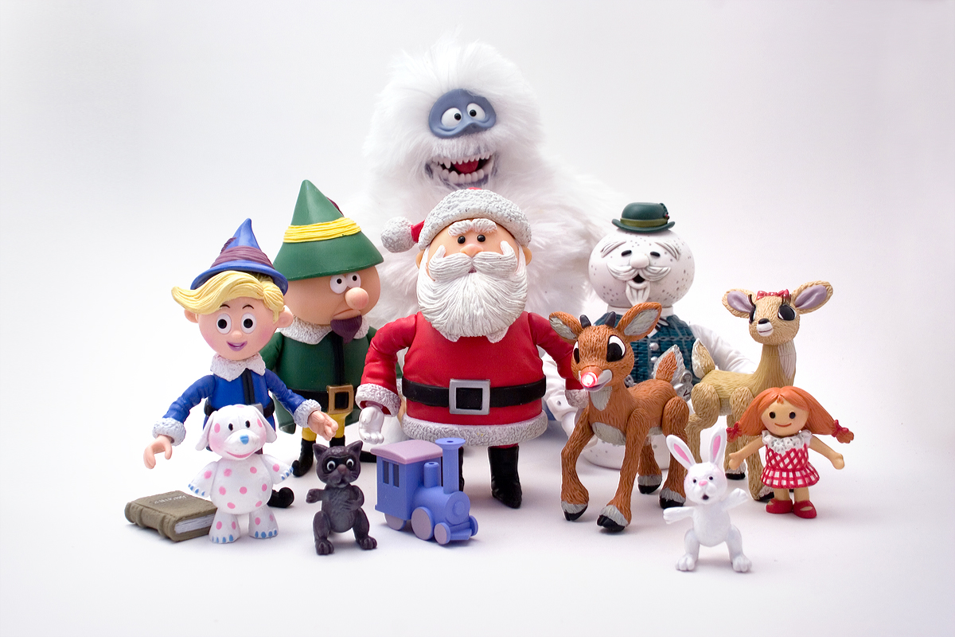
The Land of Misfit Figures

Slide 13
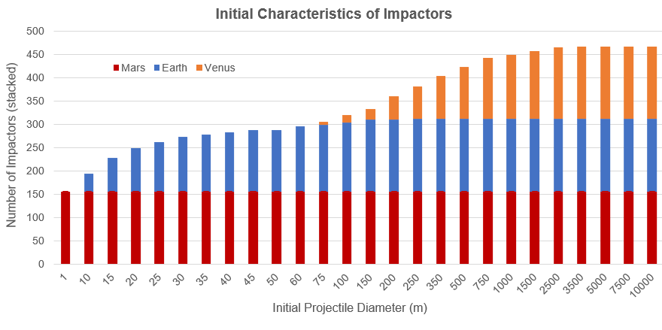
Venus
Earth
Mars
Mars
Mars
Earth
Earth
Venus
Venus
Mars
Earth
Venus

Slide 14
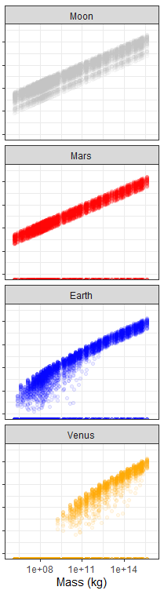
Initial Projectile Characteristic vs. Final Crater Diameter
Notes:
flag.vel(1) = 1971;
flag.shape(1) = 1.21;
flag.drag(1) = 0.47;
flag.ang(1) = 1971;
flag.lift(1) = 0.001;
flag.mass(1) = 1971;
flag.htc(1) = 0.02;
flag.hoa(1) = 5e6;
flag.zrho(1) = 1;
FLAVRS = load('ProjPop_Theo_v6_hypervel_FLAVRSM.mat'); % (220526)
FLAVRS = FLAVRS.FLAVRS;
# ---------------------------------------------------------------------
# ---------------------------------------------------------------------
# Initial Diameter vs. Crater Diameter
# Mars
# Pull data
x1 = na.omit(M_brk$IntVel.kms/1000)
y1 = na.omit(M_brk$CraterDiam.m/1000)
# Plot 2d density
p1 = ggplot(as.data.frame(cbind(x1,y1)), aes(x=x1, y=y1) ) +
labs(x='Initial Projectile Velocity (km/s)', y='Final Crater Diameter (km)') +
stat_density_2d(aes(fill = ..ndensity..), geom = "raster", contour = FALSE) +
scale_fill_distiller(direction=1, limits=c(0,1)) + geom_point(alpha=0.025, colour = 'black') +
scale_y_continuous(trans='log10', limits=c(0.01,350), labels=scales::comma) +
scale_x_continuous(limits=c(0,45), labels=scales::comma) +
theme_bw ()
p1
# Earth
# Pull data
x2 = na.omit(E_brk$IntVel.kms/1000)
y2 = na.omit(E_brk$CraterDiam.m/1000)
# Plot 2d density
p2 = ggplot(as.data.frame(cbind(x2,y2)), aes(x=x2, y=y2) ) +
labs(x='Initial Projectile Velocity (km/s)', y='Final Crater Diameter (km)') +
stat_density_2d(aes(fill = ..ndensity..), geom = "raster", contour = FALSE) +
scale_fill_distiller(direction=1, limits=c(0,1)) + geom_point(alpha=0.025, colour = 'black') +
scale_y_continuous(trans='log10', limits=c(0.01,350), labels=scales::comma) +
scale_x_continuous(limits=c(0,45), labels=scales::comma) +
theme_bw ()
p2
# Venus
# Pull data
x3 = na.omit(V_brk$IntVel.kms/1000)
y3 = na.omit(V_brk$CraterDiam.m/1000)
# Plot 2d density
p3 = ggplot(as.data.frame(cbind(x3,y3)), aes(x=x3, y=y3) ) + ylim(0,350) +
labs(x='Initial Projectile Velocity (km/s)', y='Final Crater Diameter (km)') +
stat_density_2d(aes(fill = ..ndensity..), geom = "raster", contour = FALSE) +
scale_fill_distiller(direction=1, limits=c(0,1)) + geom_point(alpha=0.025, colour = 'black') +
scale_y_continuous(trans='log10', limits=c(0.01,350), labels=scales::comma) +
scale_x_continuous(limits=c(0,45), labels=scales::comma) +
theme_bw ()
p3
# ---------------------------------------------------------------------
# Mass vs. Crater Diameter
# Mars
# Pull data
x4 = na.omit(M_brk$IntMass.kg)
y4 = na.omit(M_brk$CraterDiam.m/1000)
# Plot 2d density
p4 = ggplot(as.data.frame(cbind(x4,y4)), aes(x=x4, y=y4) ) + ylim(0,350) +
labs(x='Initial Projectile Mass (kg)', y='Final Crater Diameter (km)') +
stat_density_2d(aes(fill = ..ndensity..), geom = "raster", contour = FALSE) +
scale_fill_distiller(direction=1, limits=c(0,1)) + geom_point(alpha=0.025, colour = 'black') +
scale_y_continuous(trans='log10', limits=c(0.01,350), labels=scales::comma) +
scale_x_continuous(trans='log10', labels = function(x) format(x, scientific = TRUE)) +
theme_bw ()
p4
# Earth
# Pull data
x5 = na.omit(E_brk$IntMass.kg)
y5 = na.omit(E_brk$CraterDiam.m/1000)
# Plot 2d density
p5 = ggplot(as.data.frame(cbind(x5,y5)), aes(x=x5, y=y5) ) +
labs(x='Initial Projectile Mass (kg)', y='Final Crater Diameter (km)') +
stat_density_2d(aes(fill = ..ndensity..), geom = "raster", contour = FALSE) +
scale_fill_distiller(direction=1, limits=c(0,1)) + geom_point(alpha=0.025, colour = 'black') +
scale_y_continuous(trans='log10', limits=c(0.01,350), labels=scales::comma) +
scale_x_continuous(trans='log10', labels = function(x) format(x, scientific = TRUE)) +
theme_bw ()
p5
# Venus
# Pull data
x6 = na.omit(V_brk$IntMass.kg)
y6 = na.omit(V_brk$CraterDiam.m/1000)
# Plot 2d density
p6 = ggplot(as.data.frame(cbind(x6,y6)), aes(x=x6, y=y6) ) + ylim(0,350) +
labs(x='Initial Projectile Mass (kg)', y='Final Crater Diameter (km)') +
stat_density_2d(aes(fill = ..ndensity..), geom = "raster", contour = FALSE) +
scale_fill_distiller(direction=1, limits=c(0,1)) + geom_point(alpha=0.025, colour = 'black') +
scale_y_continuous(trans='log10', limits=c(0.01,350), labels=scales::comma) +
scale_x_continuous(trans='log10', labels = function(x) format(x, scientific = TRUE)) +
theme_bw ()
p6
# ---------------------------------------------------------------------
# Angle vs. Crater Diameter
# Mars
# Pull data
x7 = na.omit(M_brk$IntAng.deg)
y7 = na.omit(M_brk$CraterDiam.m/1000)
# Plot 2d density
p7 = ggplot(as.data.frame(cbind(x7,y7)), aes(x=x7, y=y7) ) + ylim(0,350) +
labs(x='Initial Projectile Angle (deg)', y='Final Crater Diameter (km)') +
stat_density_2d(aes(fill = ..ndensity..), geom = "raster", contour = FALSE) +
scale_fill_distiller(direction=1, limits=c(0,1)) + geom_point(alpha=0.075, colour = 'black') +
scale_y_continuous(trans='log10', limits=c(0.01,350), labels=scales::comma) +
scale_x_continuous(limits=c(0,90), labels=scales::comma) +
theme_bw ()
p7
# Earth
# Pull data
x8 = na.omit(E_brk$IntAng.deg)
y8 = na.omit(E_brk$CraterDiam.m/1000)
# Plot 2d density
p8 = ggplot(as.data.frame(cbind(x8,y8)), aes(x=x8, y=y8) ) +
labs(x='Initial Projectile Angle (deg)', y='Final Crater Diameter (km)') +
stat_density_2d(aes(fill = ..ndensity..), geom = "raster", contour = FALSE) +
scale_fill_distiller(direction=1, limits=c(0,1)) + geom_point(alpha=0.075, colour = 'black') +
scale_y_continuous(trans='log10', limits=c(0.01,350), labels=scales::comma) +
scale_x_continuous(limits=c(0,95), labels=scales::comma) +
theme_bw ()
p8
# Venus
# Pull data
x9 = na.omit(V_brk$IntAng.deg)
y9 = na.omit(V_brk$CraterDiam.m/1000)
# Plot 2d density
p9 = ggplot(as.data.frame(cbind(as.factor(x9),y9)), aes(x=x9, y=y9) ) + ylim(0,350) +
labs(x='Initial Projectile Angle (deg)', y='Final Crater Diameter (km)') +
stat_density_2d(aes(fill = ..ndensity..), geom = "raster", contour = FALSE) +
scale_fill_distiller(direction=1, limits=c(0,1)) + geom_point(alpha=0.075, colour = 'black') +
scale_y_continuous(trans='log10', limits=c(0.01,350), labels=scales::comma) +
scale_x_continuous(limits=c(0,95), labels=scales::comma) +
theme_bw ()
p9
# ---------------------------------------------------------------------
# ---------------------------------------------------------------------
d.colors <- c("2700" = 'darkblue', "3300" = 'chartreuse4', "4500" = 'chocolate1', "7800" = 'brown4')
x10 = na.omit(L_stat$IntAng.deg)
y10 = na.omit(L_stat$CraterDiam.m/1000)
df.angle <- data.frame(
"x" = factor(c(x10, x7, x8, x9)),
"y" = c(y10, y7, y8, y9),
"p" = factor(
c(
rep("Moon", length(y10)),
rep("Mars", length(y7)),
rep("Earth", length(y8)),
rep("Venus", length(y9))),
levels = c("Moon", "Mars", "Earth", "Venus"),
labels = c("Moon", "Mars", "Earth", "Venus"))
)
# Basic violin plot
p <- ggplot(df.angle, aes(x=x, y=y, fill = p) ) +
theme_bw()+
scale_y_continuous(trans='log10', limits=c(0.01,350), labels=scales::comma) +
geom_violin(position = 'identity', alpha = 0.25, colour = 'black')+
scale_fill_manual(values= c("Moon" = 'gray', "Mars" = 'red', "Earth" = 'blue', "Venus" = 'orange'),
labels = levels(df.velma$p))+
theme(legend.position = "none", aspect.ratio = 0.75)+
facet_wrap(~p, nrow = 4)+
labs(x = "Angle (deg.)", y = "Final Crater Diameter (km)")
p
# ---------------------------------------------------------------------
x12 <- na.omit(L_stat$IntMass.kg)
df.mass <- data.frame(
"x" = c(x12, x4, x5, x6),
"y" = c(y10, y7, y8, y9),
"p" = factor(
c(
rep("Moon", length(y10)),
rep("Mars", length(y7)),
rep("Earth", length(y8)),
rep("Venus", length(y9))),
levels = c("Moon", "Mars", "Earth", "Venus"),
labels = c("Moon", "Mars", "Earth", "Venus")),
"d" = factor(
c(
na.omit(L_stat$`Density.kg/m3`),
na.omit(M_brk$`Density.kg/m3`),
na.omit(E_brk$`Density.kg/m3`),
na.omit(V_brk$`Density.kg/m3`))
)
)
p.mass <- ggplot(df.mass, aes(x=x, y=y, colour = p) ) +
theme_bw()+
scale_y_continuous(trans='log10', limits=c(0.01,350), labels=scales::comma)+
scale_x_continuous(trans= 'log10', limits = c(10^6, 10^16))+
geom_point(alpha = 0.08)+
scale_colour_manual(values= c("Moon" = 'gray', "Mars" = 'red', "Earth" = 'blue', "Venus" = 'orange'),
labels = levels(df.velma$p))+
theme(aspect.ratio = 0.75,
axis.text.y = element_blank(),
legend.position = 'none')+
facet_wrap(~p, nrow = 4)+
labs(x = "Mass (kg)", y = NULL, colour = expression(paste("Density (kg/m"^"3", ")")))
p.mass
# ---------------------------------------------------------------------
x13 <- na.omit(L_stat$IntVel.kms/1000)
df.angle <- data.frame(
"x" = factor(c(x13, x1, x2, x3)),
"y" = c(y10, y1, y2, y3),
"p" = factor(
c(
rep("Moon", length(y10)),
rep("Mars", length(y1)),
rep("Earth", length(y2)),
rep("Venus", length(y3))),
levels = c("Moon", "Mars", "Earth", "Venus"),
labels = c("Moon", "Mars", "Earth", "Venus"))
)
# Basic violin plot
p <- ggplot(df.angle, aes(x=x, y=y, fill = p) ) +
theme_bw()+
scale_y_continuous(trans='log10', limits=c(0.01,350), labels=scales::comma) +
geom_violin(position = 'identity', alpha = 0.25, colour = 'black')+
scale_fill_manual(values= c("Moon" = 'gray', "Mars" = 'red', "Earth" = 'blue', "Venus" = 'orange'),
labels = levels(df.velma$p))+
theme(legend.position = "none", aspect.ratio = 0.75)+
facet_wrap(~p, nrow = 4)+
labs(x = "Velocity (km/s)", y = "Final Crater Diameter (km)")
p
# ---------------------------------------------------------------------
x14 <- na.omit(L_stat$PanFact)
x15 = na.omit(M_brk$PanFact)
x16 = na.omit(E_brk$PanFact)
x17 = na.omit(M_brk$PanFact)
df.panfact <- data.frame(
"x" = c(x14, x15, x16, x17),
"y" = c(y10, y1, y2, y3),
"p" = factor(
c(
rep("Moon", length(y10)),
rep("Mars", length(y7)),
rep("Earth", length(y8)),
rep("Venus", length(y9))),
levels = c("Moon", "Mars", "Earth", "Venus"),
labels = c("Moon", "Mars", "Earth", "Venus")),
"d" = factor(
c(
na.omit(L_stat$PanFact),
na.omit(M_brk$PanFact),
na.omit(E_brk$PanFact),
na.omit(M_brk$PanFact)
)
))
p.panfact <- ggplot(df.panfact, aes(x=x, y=y, colour = p) ) +
theme_bw()+
scale_y_continuous(trans='log10', limits=c(0.01,350), labels=scales::comma)+
scale_x_continuous(limits = c(0, 50))+
geom_point(alpha = 0.25)+
scale_colour_manual(values= c("Moon" = 'gray', "Mars" = 'red', "Earth" = 'blue', "Venus" = 'orange'),
labels = levels(df.velma$p))+
theme(aspect.ratio = 0.75,
axis.text.y = element_blank(),
legend.position = 'none')+
facet_wrap(~p, nrow = 4)+
labs(x = "Pancake Factor", y = NULL, colour = expression(paste("Density (kg/m"^"3", ")")))
p.panfact
# ---------------------------------------------------------------------
# ---------------------------------------------------------------------

Slide 15
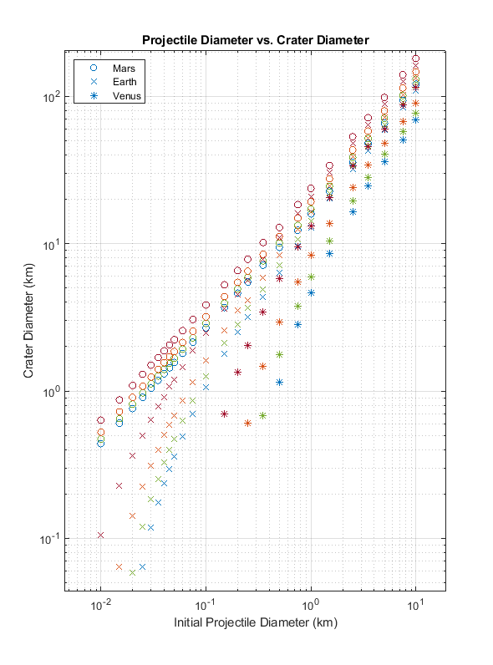
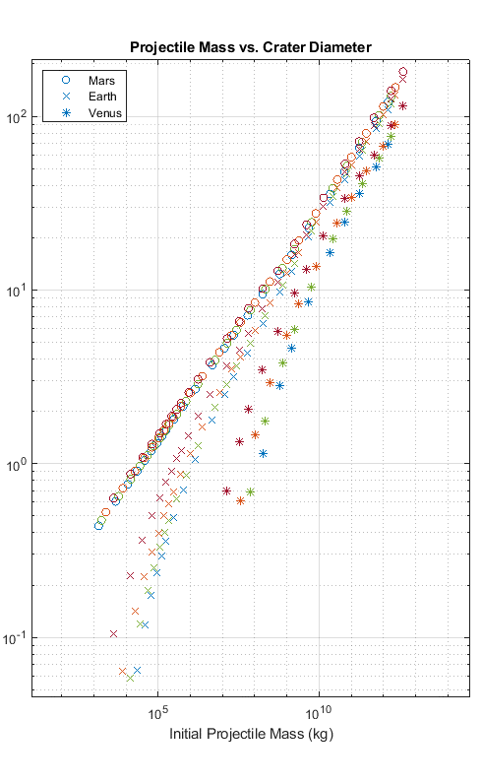

Slide 16

Model Sensitivity to Atmospheric Effect Equations
Change in
Velocity
Model
Parameters
dV/dt = Varies
dθ/dt = 1971
dm/dt = 1971
Sf = 1.21
CD = 0.47
CL = 0.001
Cht = 0.02
Cha = 5e6
2004
2003
2005
Change in
Angle
Model
Parameters
dV/dt = 1971
dθ/dt = Varies
dm/dt = 1971
Sf = 1.21
CD = 0.47
CL = 0.001
Cht = 0.02
Cha = 5e6
Change in
Mass
Model
Parameters
dV/dt = 1971
dθ/dt = 1971
dm/dt = Varies
Sf = 1.21
CD = 0.47
CL = 0.001
Cht = 0.02
Cha = 5e6
1983
1958

Slide 17
Model Sensitivity to Atmospheric Effect Equations
Change in
Velocity
2004
2003
2005
Change in
Angle
Change in
Mass
1983
1958

Slide 18
Shape Factor
Drag
Coeff.
Heat of Ablation
Heat
Coeff.
Lift
Coeff.

Slide 19
A. Shape Factor
1995
1995
4.28
1.21
4.28
1.21
B. Drag Coefficient
2.0
0.47
2.0
0.47
C. Heat of Ablation
1.89e6
5e6
1.89e6
8.01e6
8.01e6
0.6
D. Heat Transfer Coeff.
0.1
0.6
0.01
0.02
0.01
0.1
E. Lift Coefficient
E. Lift Coefficient

Slide 20
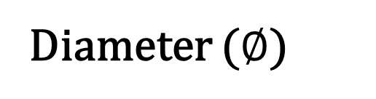
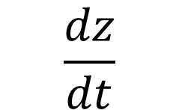
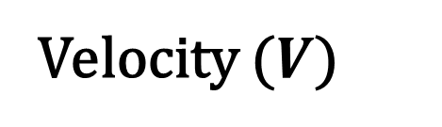
A. Projectile Characteristics
Density (ρ)
Diameter ($∅$)
Velocity ($V$)
Angle (θ)
M
Iron
1 m
3 km/s
90 ̊
P
Stony-Iron
45 ̊
S
Stony
15 ̊
C
Chondritic
950 km
40 km/s
B. Atmospheric Effects
C. Atmospheric Conditions
$$\frac{dz}{dt}$$
Disintegration
Top of Atmosphere
Gravity
$$\frac{dV_{N}}{dt}$$
Dispersion
z_{b}
g _{T}
Altitude
Atmospheric
Profiles
Fragmentation
V _{Ni}
Airburst*
Surface
z
Pressure
$$\frac{dN}{dt}$$
N_{i}
z*
V _{Nf}
D_{sc}
Simple-to-Complex
Crater Diameter
P(z)
N_{f}
Field*
Temperature
$$\frac{dm}{dt}$$
Ablation
Multi-Floored*
P₀
T(z)
Density
m _{i}
m_{f}
T₀
ρ_{a} (z)
$$\frac{dθ}{dt}$$
Angle
Simple
Target
Characteristics
ρ₀
θ_{i}
Impact
Characteristics
Scale
Height
θ_{f}
Complex
H_{T}
$$\frac{dV}{dt}$$
Velocity
Crater
Formation
R_{T}
Surface
Density
ρ_{T}
V_{i}
V_{f}
Target
Radius
* Not to Scale

Slide 21
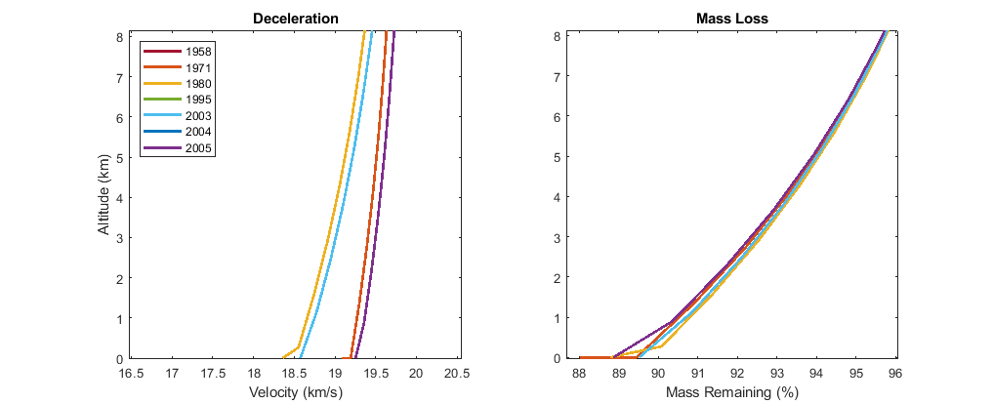
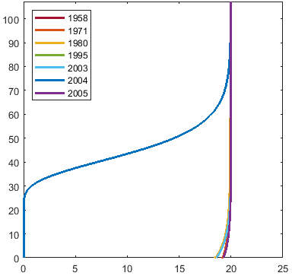
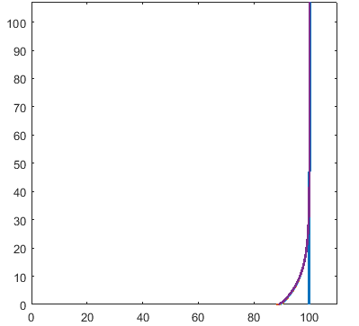
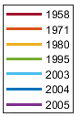
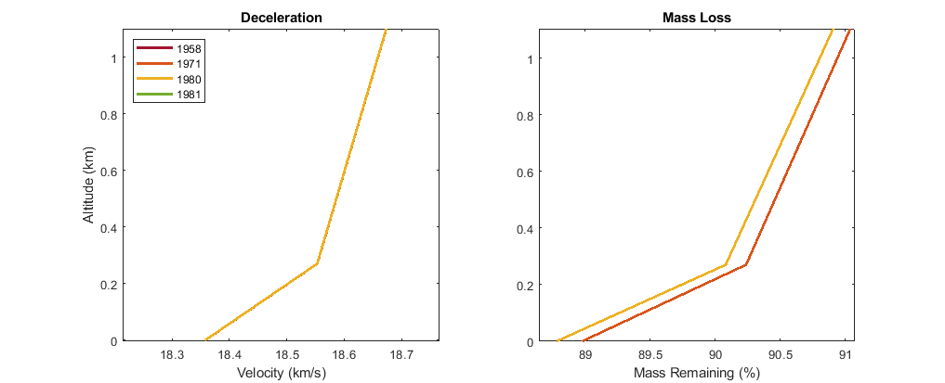
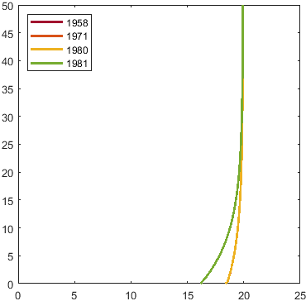
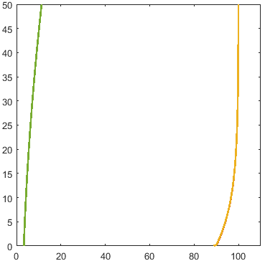
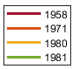
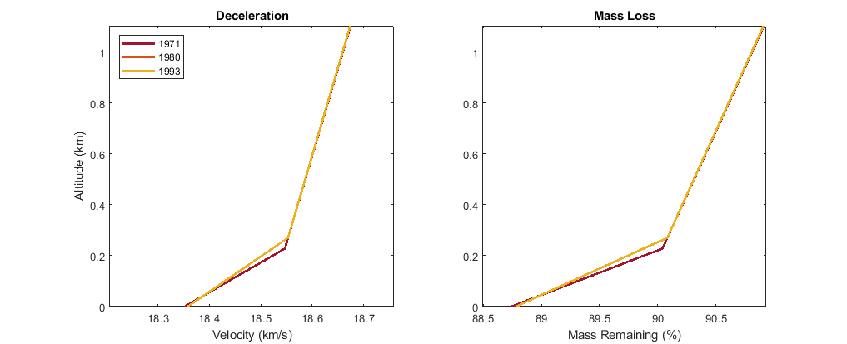
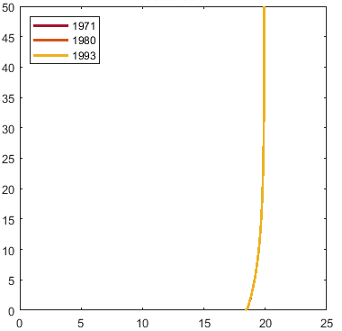
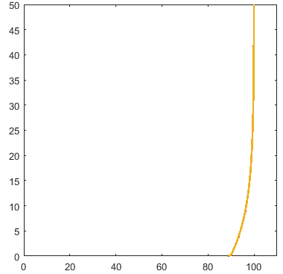
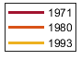
Velocity
Equations
2004
2004
1995, 2005
1971
Model
Parameters
dV/dt = Varies
dθ/dt = 1980
dm/dt = 1980
Sf = 1.21
CD = 0.5
CL = 0.01
Cht = 0.02
Cha = 5e6
1958, 2003
1971, 1995, 2005
1980
1958, 1980, 2003
Mass
Equations
1981
1981
Model
Parameters
dV/dt = 1980
dθ/dt = 1980
dm/dt = Varies
Sf = 1.21
CD = 0.5
CL = 0.01
Cht = 0.02
Cha = 5e6
1958, 1971, 1980
1980
1958, 1971
Angle
Equations
Model
Parameters
dV/dt = 1980
dθ/dt = Varies
dm/dt = 1980
Sf = 1.21
CD = 0.5
CL = 0.01
Cht = 0.02
Cha = 5e6
1993
1993
1971, 1980
1971, 1980

Slide 22
N₁
N₂
N₃
N₄
N₃
N₄
N₃
N₁
N₁
N₂
N₁
N₂
N₁
N₂
N₁
N₁
N₁
N₃
N₂

Slide 24
Initial Characteristic vs. Final Crater Diameter
Air Burst Zone
Air Burst Zone
Air Burst Zone
Air Burst Zone

Slide 25
Initial Characteristic vs. Final Crater Diameter
Air Burst
Air Burst
Air Burst
Air Burst

Slide 26
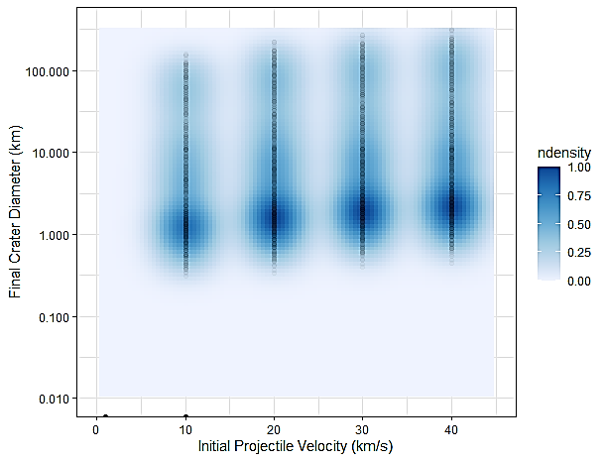
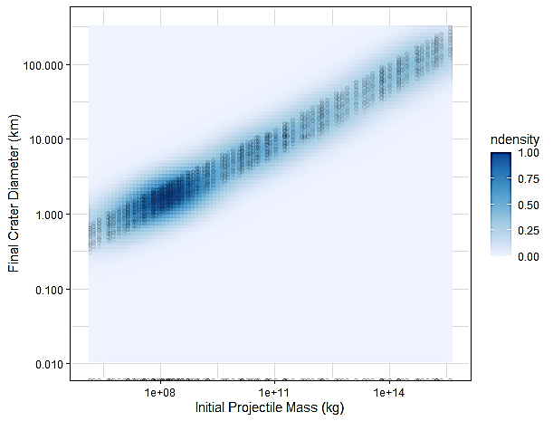
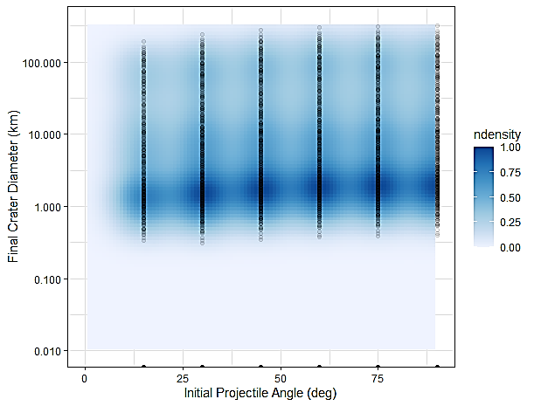
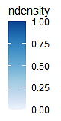
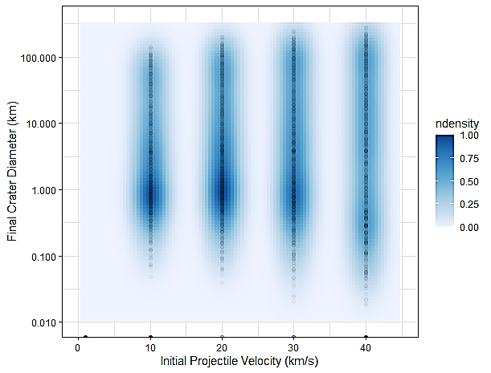
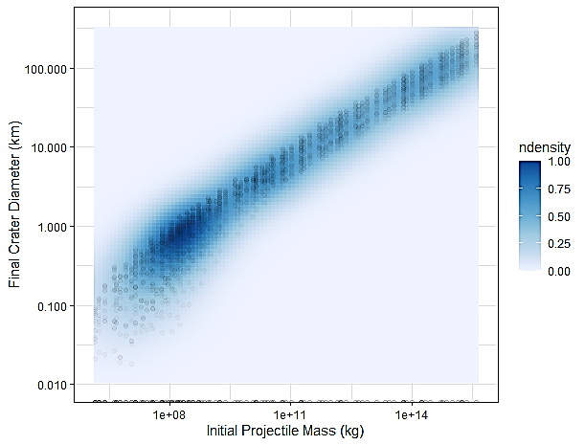
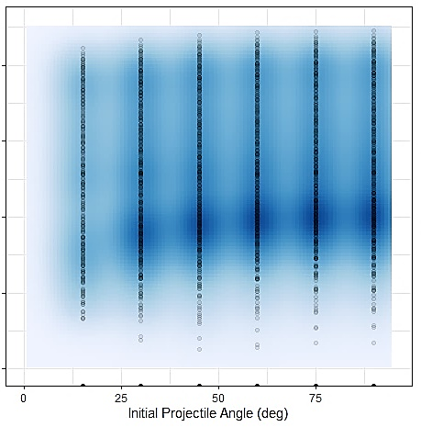
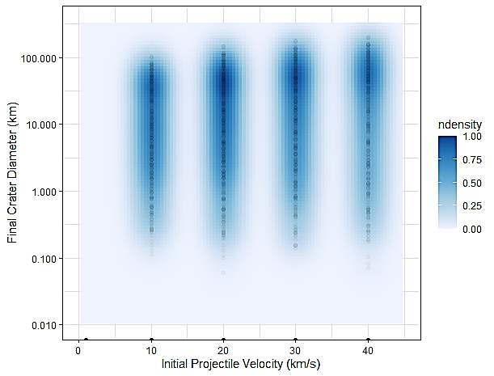
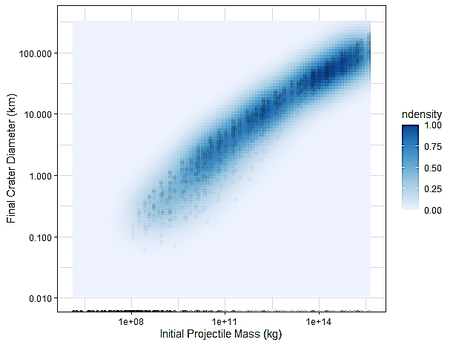
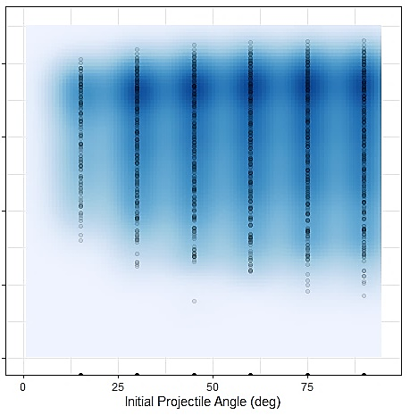






Mars
$$D_{f}=1.532∙{M_{i}}^{0.2706}$$
$$R^{2}=0.9077$$
Mars
Mars
Mars
Earth
$$D_{f}=0.7988∙{M_{i}}^{0.3505}$$
$$R^{2}=0.9059$$
Earth
Earth
Earth
Venus
$$D_{f}=0.1609∙{M_{i}}^{0.8876}$$
$$R^{2}=0.8876$$
Venus
Venus
Venus

Slide 27


Ablation
Ablation & Breakup
1 km
1 km
1 km
1 km
Figure 8. Theoretical initial projectile vs. final crater diameter. Initial projectile diameters (n = 3,000) and the relative crater diameter formed on the Moon (square), Mars (circle), Earth (x), and Venus (asterisk). Atmospheric effects included in the runs were ablation (left) and ablation with breakup added (right). The color denotes the projectile density (iron, stony iron, stony, or chondritic). All projectiles have an initial velocity of 20 km/s and an angle of 45 degrees relative to horizontal.

Slide 28



10 m
10 m
40 km/s
30 km/s
20 km/s
10 km/s
10 m
100 m
40 km/s
30 km/s
20 km/s
10 km/s
10 m
100 m
1 km
10 km
Notes:
Ablation (pop1)

Slide 29



100 m
100 m
30 km/s
20 km/s
10 km/s
100 m
30 km/s
20 km/s
10 km/s
40 km/s
100 m
100 m
1 km
2.5 km
Notes:
Ablation & breakup (pop2)

Slide 30


Chixculub
Chixculub
AEM Impact Characteristics
Ø = 13.9 km
V = 16.8 km/s
Θ = ~45°
M = 99.8%
Canyon Diablo
Canyon Diablo
AEM Impact Characteristics
Ø = 42 – 46 m
V = 7 – 13 km/s
Θ = ~45°
M = 62 – 79%
Chelyabinsk
Chelyabinsk
AEM Impact Characteristics
Ø = 0 – 17 m
V = 0 – 0.5 km/s
Θ = ~20°
M = 0 – 56%
Tunguska
Tunguska
AEM Impact Characteristics
Ø = 43 – 43 m
V = 1 – 9 km/s
Θ = ~45°
M = 56 – 65 %

Slide 31


Chixculub-like Projectile
Chixculub-like Projectile
Hypothesized Initial Projectile
ρ = 3,300 kg/m3
Ø = 17,500 m
V = 20 km/s
Θ = 45°
Canyon Diablo-like Projectile
Canyon Diablo-like
Projectile
Hypothesized Initial Projectile
ρ = 7,800 kg/m3
Ø = 40 m
V = 20 km/s
Θ = 45°
Chelyabinsk-like Projectile
Chelyabinsk-like Projectile
Hypothesized Initial Projectile
ρ = 4,500 kg/m3
Ø = 22 m
V = 19
Θ = 20°
Tunguska-like Projectile
Tunguska-like Projectile
Hypothesized Initial Projectile
ρ = 3,300 kg/m3
Ø = 60 m
V = 20 km/s
Θ = 45°

Slide 32


Ries Crater Projectile
Meteor Crater Projectile
Chelyabinsk Fireball
Ø = 1,500 m V = 20 km/s
ρ = 2,700 kg/m3 Θ = 45°
Ø = 40 m V = 20 km/s
ρ = 8000 kg/m3 Θ = 45°
Ø = 22 m V = 19 km/s
ρ = 3,300 kg/m3 Θ = 20°
Impact Characteristics
Ø = 1,500 m V = 20 km/s
ρ = 2,700 kg/m3 Θ = 45°

Slide 33


1980 Equations
with
breakup
without
breakup
% Spread of ensamble flags
flag_vel = [1980]; %[1958,1971,1980,1993,1995,2003,2005], [1958,1971,1980,1993,1995,2003,/2004/,2005];
flag_shape = [1.21]; % [1.21,/1.919/]
flag_drag = [0.5]; % [0.5,1,2,1971,2016]
flag_ang = [1980]; % [1971,1980,1993]
flag_lift = [0.01]; % [0,0.001,0.01,0.1]
flag_mass = [1980]; %[1958,1971,1980], [1958,1971,1980,/1981/,/1993/,/2004/];
flag_htc = [0.02]; % [0,0.0,0.1,0.6]
flag_hoa = [5e6]; % [1.89e6,5e6,8.01e6];
Without breakup
Dt (km) Type Df (km) Dd (km)
1.10 1 1.38 0.30
1.18 1 1.48 0.32
98.845 2 180.64 4.97
With breakup
Dt (km) Type Df (km) Dd (km) Zbreak (km)
0.00 0 0 0 64.48
0.83 1 1.03 0.22 19.45
98.5 2 180.64 4.97 0
Actual
Dt (km) Type Df (km) Dd (km) Zbreak (km)
0.00 0 0 0 0
0.00 1 1.186 0.17
0.00 2 180.0 20.0 0

Slide 34

1971 Equations
with
breakup
without
breakup
% Spread of ensamble flags
flag_vel = [1971]; %[1958,1971,1980,1993,1995,2003,2005], [1958,1971,1980,1993,1995,2003,/2004/,2005];
flag_shape = [1.21]; % [1.21,/1.919/]
flag_drag = [0.5]; % [0.5,1,2,1971,2016]
flag_ang = [1971]; % [1971,1980,1993]
flag_lift = [0.01]; % [0,0.001,0.01,0.1]
flag_mass = [1971]; %[1958,1971,1980], [1958,1971,1980,/1981/,/1993/,/2004/];
flag_htc = [0.02]; % [0,0.0,0.1,0.6]
flag_hoa = [5e6]; % [1.89e6,5e6,8.01e6];
Without breakup
Dt (km) Type Df (km) Dd (km)
1.13 1 1.41 0.31
1.20 1 1.50 0.33
98.87 2 180.68 4.97
With breakup
Dt (km) Type Df (km) Dd (km) Zbreak (km)
0.00 0 0 0 64.46
0.89 1 1.12 0.24 19.34
98.87 2 180.68 4.97 0
Actual
Dt (km) Type Df (km) Dd (km) Zbreak (km)
0.00 0 0 0 0
0.00 1 1.186 0.17 19.45
0.00 2 180.0 20.0 0

Slide 35
Chixculub-like Projectile
Chixculub-like Projectile
Hypothesized Initial Projectile
ρ = 3,300 kg/m3
Ø = 17,500 m
V = 20 km/s
Θ = 45°
Canyon Diablo-like Projectile
Canyon Diablo-like
Projectile
Hypothesized Initial Projectile
ρ = 7,800 kg/m3
Ø = 40 m
V = 20 km/s
Θ = 45°
Chelyabinsk-like Projectile
Chelyabinsk-like Projectile
Hypothesized Initial Projectile
ρ = 4,500 kg/m3
Ø = 22 m
V = 19
Θ = 20°
Tunguska-like Projectile
Tunguska-like Projectile
Hypothesized Initial Projectile
ρ = 3,300 kg/m3
Ø = 60 m
V = 20 km/s
Θ = 45°

Slide 36


Slide 37


Slide 38




Moon
Mars
Earth
Venus

Slide 39




Slide 40












Mars
Mars
Mars
Earth
Earth
Earth
Venus
Venus
Venus

Slide 41
Mars
Mars
Mars
Mars
Earth
Earth
Earth
Earth
Venus
Venus
Venus
Venus

Slide 42












Spread of Ensemble
1971
1980
1958
1980
1958, 1971, 1980
1958
1971
0.6
0.6
0.1
0.6
0.1
0.1
0.6
0.01
0.02
0.01
0.01, 0.02
0.02
0.01
Mass
Equations
1981
1981
Model
Parameters
dV/dt = 1980
dθ/dt = 1980
dm/dt = Varies
Sf = 1.21
CD = 0.5
CL = 0.01
Cht = 0.02
Cha = 5e6
1958, 1971, 1980
1980
1958, 1971
0
0
0.1
0.1
Angle
Equations
Model
Parameters
dV/dt = 1980
dθ/dt = Varies
dm/dt = 1980
Sf = 1.21
CD = 0.5
CL = 0.01
Cht = 0.02
Cha = 5e6
1993
1993
1971, 1980
1971, 1980
2
0.5
2016
2016
1, 1971
2
Velocity
Equations
2004
2004
2004
1995, 2005
1958, 1980, 2003
1971,
1995, 2005
2004
1971
Model
Parameters
dV/dt = Varies
dθ/dt = 1980
dm/dt = 1980
Sf = 1.21
CD = 0.5
CL = 0.01
Cht = 0.02
Cha = 5e6
1958, 2003
1971, 1995, 2005
1980
1958, 1980, 2003

Slide 43



Ablation Only
Ø 10m
WRONG
Y-AXIS
Ø 10m
Ø 100m
Ø 10m
30 km/s
20 km/s
10 km/s
40 km/s
Ø 10m
Ø 10m
Ø 100m
Ø 1km
Ø 10km

Slide 44



Ablation and Breakup
20 km/s
10 km/s
Ø 10m
Ø 10m
30 km/s
20 km/s
40 km/s
10 km/s
Ø 10m
Increase increment
Ø 10m
Ø 1km
Ø 10km
30 km/s
20 km/s
10 km/s

Slide 45



Ablation and Breakup
Ø 10m
Ø 10m
30 km/s
20 km/s
10 km/s
40 km/s
Ø 10m
30 km/s
20 km/s
10 km/s
Ø 100m
Increase increment
Ø 1km
Ø 2.5km

